Slide 1
Brain Computer Interface can translate simple thought into speech
By muhammad harith bin zainudin
192171

Slide 2
Team of New York-based researchers
Led by Dr. Nima Mesgarani (associate professor at Columbia University)
Dr Ashesh Dinesh(Neuroscience Institute)
Reconstruct words using only brain activity
Smartphone translate thought into speech

Slide 3
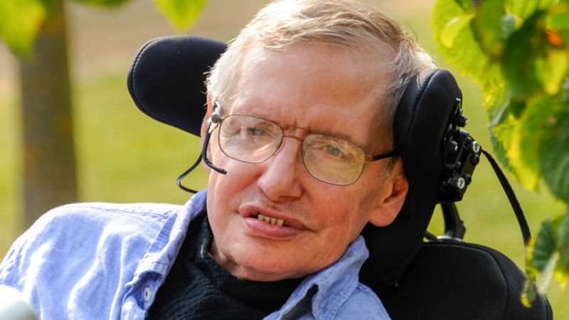
Restore speech for
Stroke
Amyotrophic Lateral Sclerosis(ALS)
Stephen Hawking
How Indian Engineers Helped Stephen Hawking 'talk’ (YOUTUBE)

Slide 4
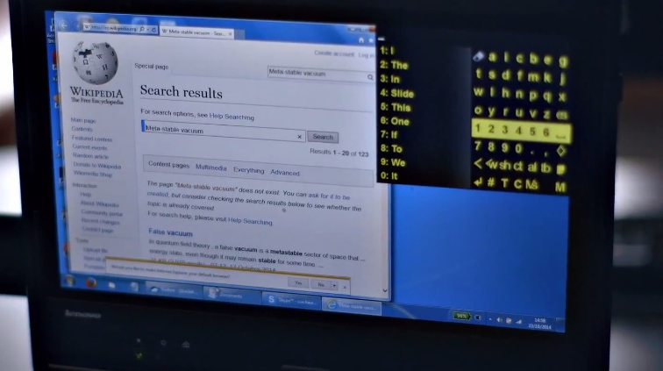

Slide 5
Searching for alternative human computer interaction methods
Brain connected smartphone - text using only mind
Still far from reality

Slide 6
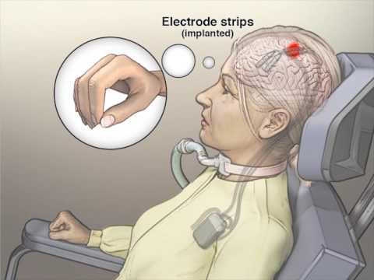

Began by examining brain activity of epilepsy patients
Had electrode implant already
Speak zero to nine
Record brain activity
Interpret
Train neural network - program that
Imitates neuron structure

Slide 7
Conclusion
“It may take a decade before this technology becomes available”
“We need more progress both in long-term, bio-compatible implantable electrodes and/or breakthrough technologies in non-invasive neural recording methods. We also need a better understanding of how the brain represents speech, so that we can refine our decoding methods.”

